Slide 1

HIGH CLOUD AIRLINES
An Analytical Study of Airline Performance Metrics

Slide 2


TEAM
Usha A
Charan R
Jayanth Gowda S D
Vilas Banwariya
Siddhant Nagesh Wakade
Aditya Singh
Sakshi Dilip Kothawade

Slide 3
CONTENTS
INTRODUCTION
CHALLENGES FACED
1ST KPI – CALENDAR
2ND KPI – LOAD FACTOR ANALYSIS ON A YEARLY, QUARTERLY, MONTHLY BASIS
3RD KPI – LOAD FACTOR PERCENTAGE ON A CARRIER NAME BASIS
4TH KPI – TOP 10 CARRIER NAMES BASED ON PASSENGER PREFERENCE
5TH KPI – TOP (FROM-TO CITY) BASED ON NUMBER OF FLIGHTS
6TH KPI – LOAD FACTOR PERCENTAGE ON A WEEKDAY AND WEEKEND BASIS
7TH KPI – SEARCH CAPABILITY TO FIND THE FLIGHTS BETWEEN SOURCE AND DESTINATION
8TH KPI – NUMBER OF FLIGHTS BASED ON DISTANCE GROUP
EXCEL DASHBOARD
POWERBI DASHBOARD
TABLEAU DASHBOARD
SQL QUERY
RECOMMENDATIONS
CONCLUSION

Slide 4
INTRODUCTION
The High Cloud Airlines Analysis Project focuses on analyzing airline operational and passenger data to gain meaningful business insights and support data-driven decision-making. The project examines key performance indicators such as passenger volume, load factor, route performance, carrier efficiency, and travel trends over time.
DATABASE:
The High Cloud Airlines database is a comprehensive, cleaned, and structured airline operations dataset containing over 110,000 flight records with 54 attributes. The database includes carrier-level details (airline ID, carrier code, carrier name), origin and destination information, operational metrics, and date fields (Year, Month, Day) to support time-based analysis. The database is optimized for seamless integration with MySQL, Power BI, Tableau, and Excel to deliver reliable dashboards and business insights.

Slide 5
CHALLENGES FACED
Data Quality & Cleaning Issues: The raw airline dataset contained missing values, inconsistent city/state names, and incorrect date formats, which required extensive data cleaning and validation before analysis.
Complex Data Modeling & Relationships: Creating accurate relationships between date, route, carrier, and passenger data was challenging, especially while calculating metrics like Load Factor % and ensuring correct filter and slicer interactions.
Performance & Visualization Optimization: Handling large volumes of flight data caused performance issues in dashboards. Optimizing calculations, reducing unnecessary visuals, and designing clear, user-friendly dashboards was essential for smooth analysis.

Slide 6
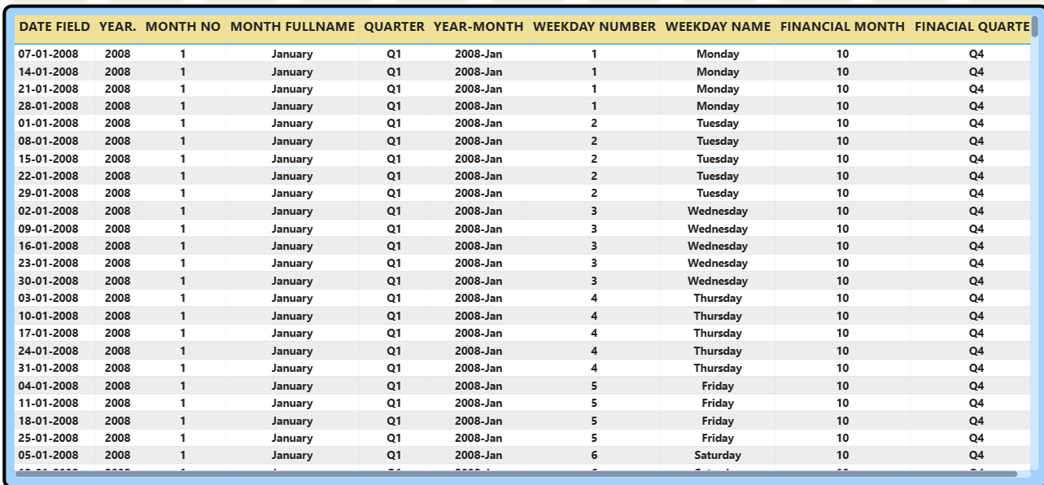
1st KPI - CALENDAR
Year, Month, and Day fields are combined to create a single Date field, ensuring accurate time-based analysis and consistent reporting across dashboards.
From the Date field, key time attributes such as Year, Month, Quarter, Weekday, and Year-Month are derived to analyze seasonal patterns, monthly trends, and day-wise performance.
Financial Month and Financial Quarter are calculated to align operational insights with the organization’s fiscal calendar, enabling better financial and strategic decision-making.

Slide 7
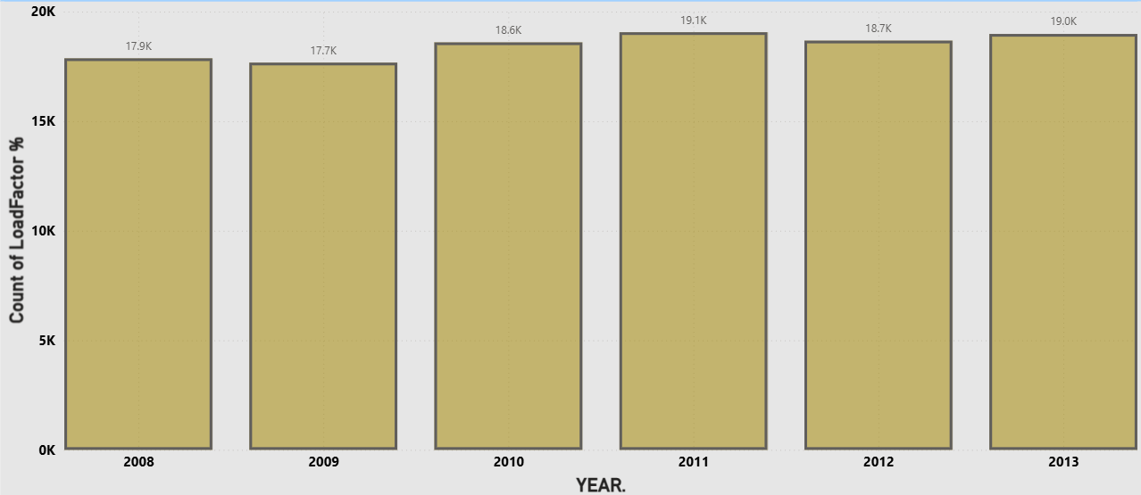
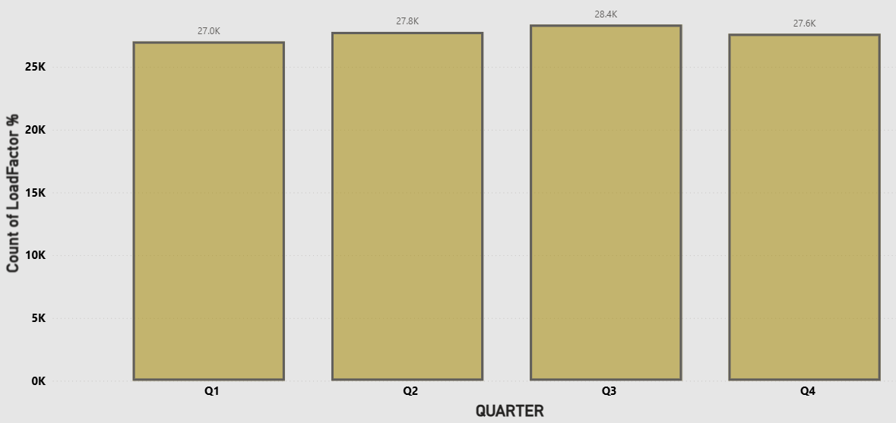
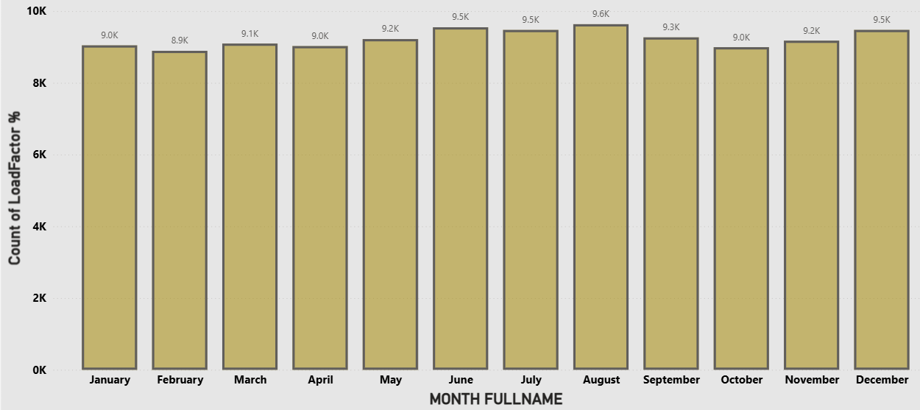
2ND KPI – LOAD FACTOR ANALYSIS ON A YEARLY, QUARTERLY, MONTHLY BASIS
1. Year-wise Load Factor:
Load factor shows a steady improvement over the years, indicating better seat utilization and increasing passenger demand.
Minor fluctuations exist, but the overall trend reflects consistent operational growth and efficiency.
2. Quarter-wise Load Factor:
Q3 records the highest load factor, highlighting peak travel demand during this period.
Q1 and Q4 are comparatively lower, indicating seasonal variations and potential off-peak opportunities.
3. Month-wise Load Factor:
Load factor gradually increases from mid-year (May–August), reflecting high travel activity during summer and holiday seasons.
Lower values in February and October suggest demand dips, useful for capacity and pricing optimization.

Slide 8
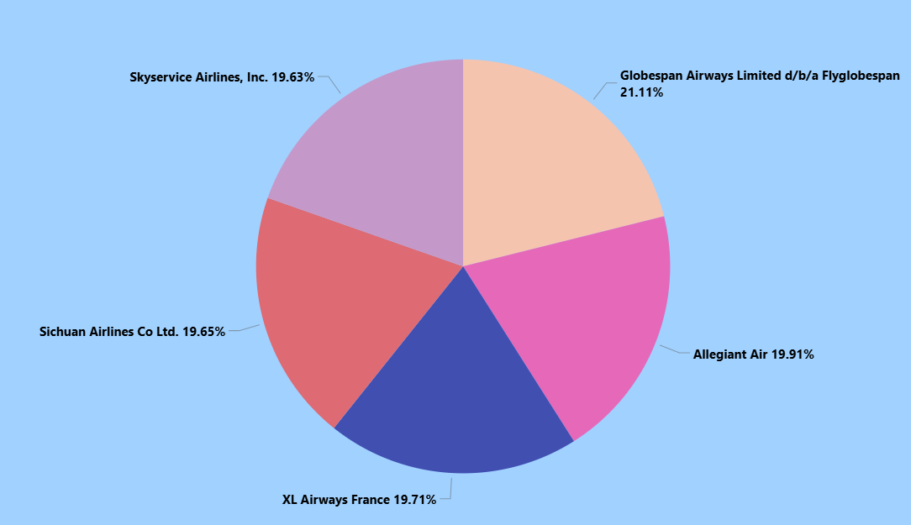
3RD KPI – LOAD FACTOR PERCENTAGE ON A CARRIER NAME BASIS
The load factor across all five carriers is consistently maintained between 19% and 21%, indicating stable demand levels and effective capacity planning within the competitive landscape.
With a 21.11% load factor, Globespan Airways is marginally leading, reflecting slightly better seat occupancy and route optimization compared to other carriers.
Other airlines i.e., Skyservice Airlines, Sichuan Airlines, XL Airways France, and Allegiant Air has maintain comparable load factors (~19–20%), suggesting strong competition and consistent operational efficiency across carriers.

Slide 9
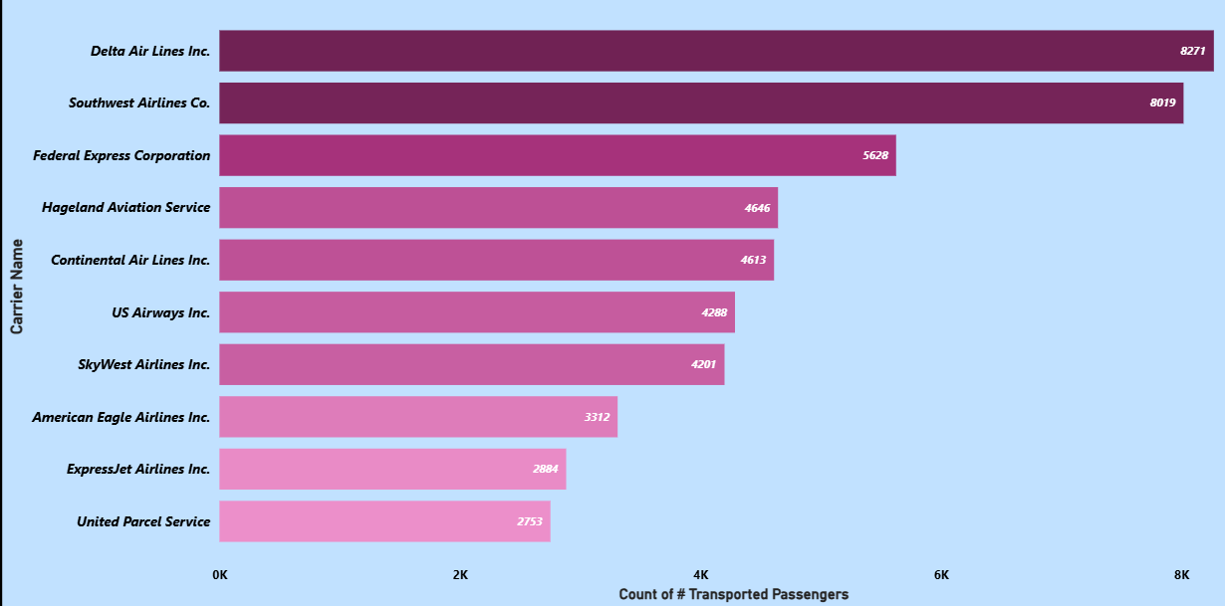
4TH KPI – TOP 10 CARRIER NAMES BASED ON PASSENGER PREFERENCE
Delta Air Lines Inc. transports the highest number of passengers (8,271), followed closely by Southwest Airlines Co. (8,019), indicating strong market dominance among top-tier carriers.
There is a noticeable drop from the top two carriers to Federal Express Corporation (5,628), highlighting a clear performance gap between leading airlines and mid-tier carriers.
Carriers like Hageland Aviation Service, Continental Air Lines, US Airways, and SkyWest show moderate passenger volumes (4K–4.6K), while ExpressJet and UPS operate at comparatively lower volumes, indicating different operational scales or business models.

Slide 10
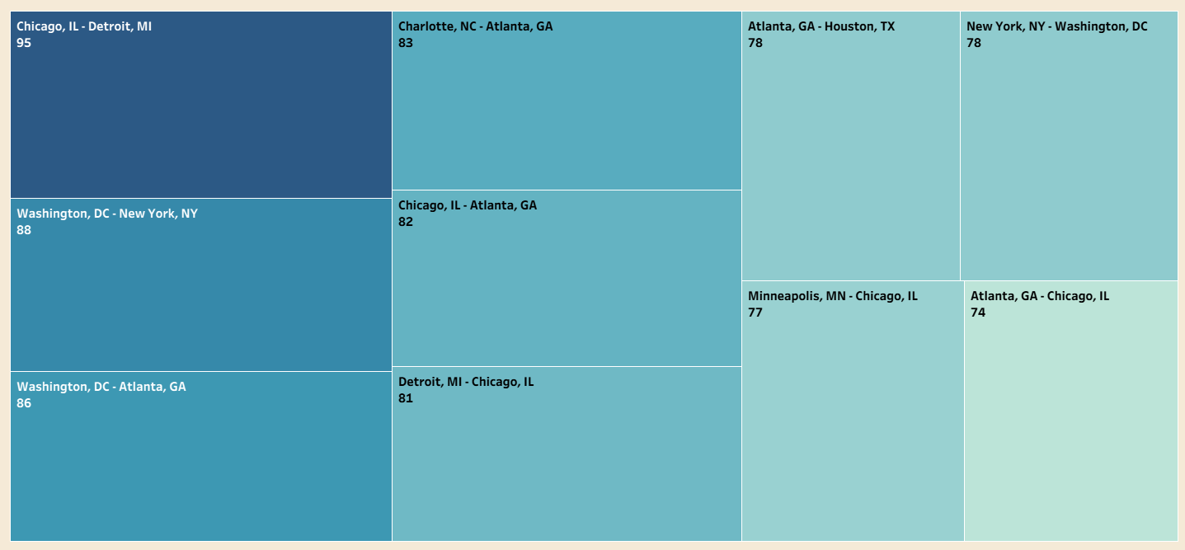
5TH KPI – TOP (FROM-TO CITY) BASED ON NUMBER OF FLIGHTS
The Chicago, IL – Detroit, MI route shows the highest value (95), indicating it is the strongest-performing and most in-demand route in the dataset.
Routes connecting major hubs such as Washington–New York (88), Washington–Atlanta (86), and Charlotte–Atlanta (83) demonstrate consistently high performance, highlighting strong intercity business and commercial traffic.
Most high-performing routes involve major aviation hubs like Chicago, Atlanta, New York, and Washington, suggesting that hub connectivity plays a critical role in overall passenger volume and route performance.

Slide 11
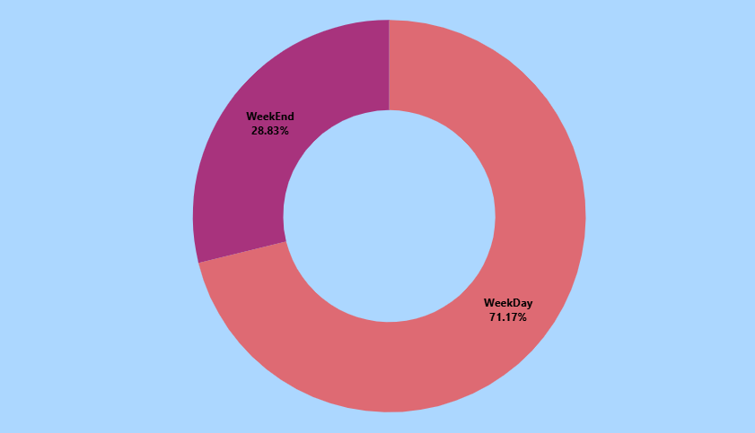
6TH KPI – LOAD FACTOR PERCENTAGE ON A WEEKDAY AND WEEKEND BASIS
Approximately 71.17% of total passengers travel on weekdays, indicating that demand is significantly higher during working days.
Only 28.83% of passengers travel on weekends, suggesting reduced business travel and slightly lower overall demand.
The strong weekday dominance indicates that business travel and corporate commuting are major contributors to overall passenger traffic, which can influence pricing, scheduling, and capacity planning strategies.

Slide 12
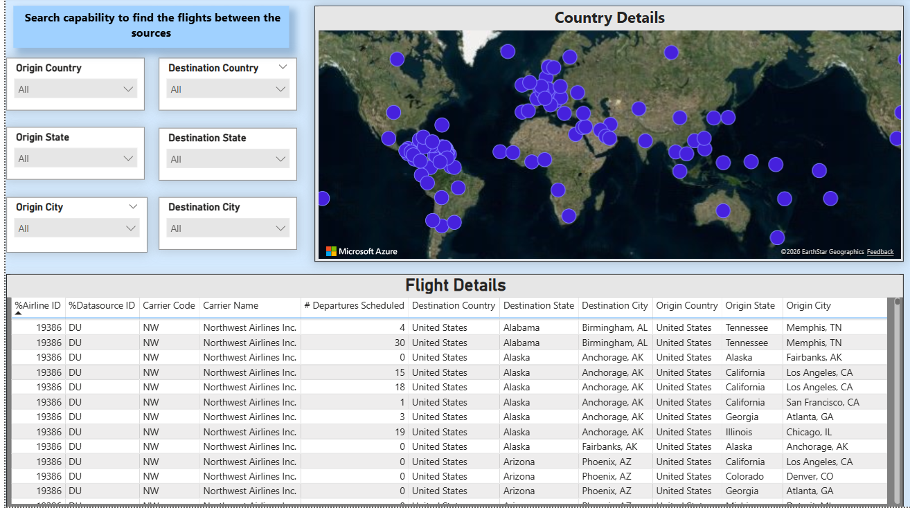
7TH KPI – SEARCH CAPABILITY TO FIND THE FLIGHTS BETWEEN SOURCE AND DESTINATION
This dashboard enables dynamic filtering across countries, states, and cities, allowing leadership to instantly evaluate route-level performance.
The interactive global map provides a consolidated view of worldwide operations, highlighting route concentration and geographic coverage.
The detailed flight-level dataset delivers deep insights into Carrier performance, Frequency of departures, Origin–destination traffic flow.

Slide 13
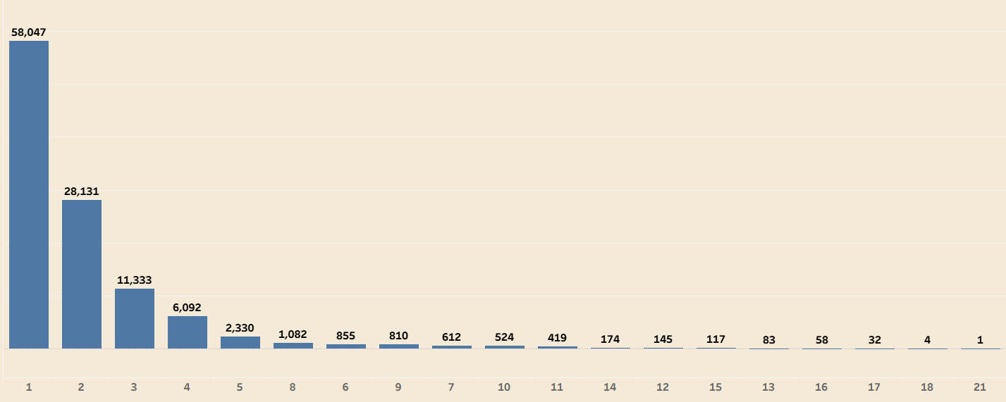
8TH KPI – NUMBER OF FLIGHTS BASED ON DISTANCE GROUP
The first category leads significantly with 58,047 departures, followed by 28,131 and 11,333 and this indicates that a small number of segments/routes contribute to the majority of total operations, showing strong concentration in key markets.
There is a steep decline after the top 3–4 categories, with volumes reducing drastically beyond 6,000 departures so this highlights a long-tail distribution where most routes operate at comparatively lower frequencies.
The data provides direction for strategic action in strengthening and protecting high-volume routes, explore redistribution of fleet capacity to improve overall network efficiency

Slide 14
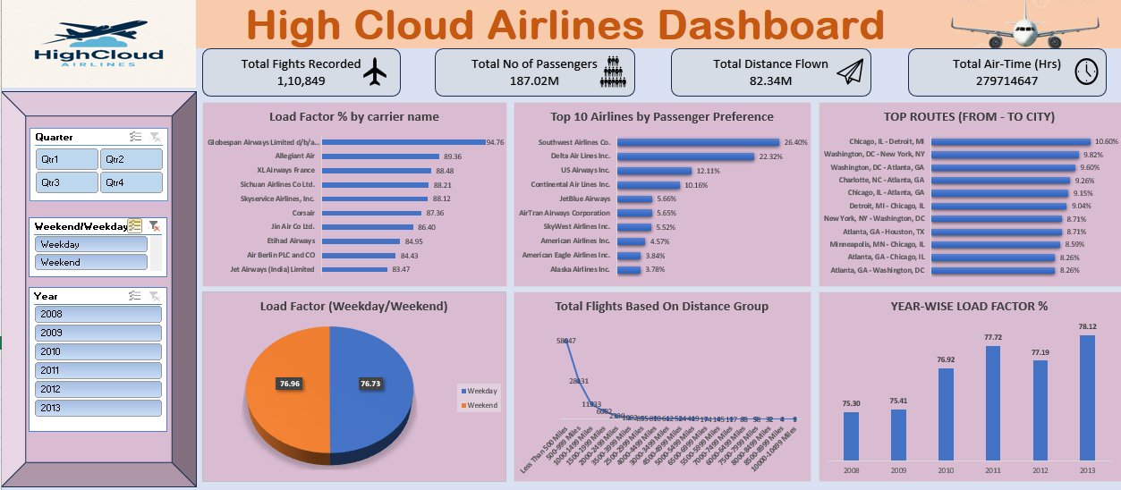
DASHBOARDS
EXCEL DASHBOARD:

Slide 15
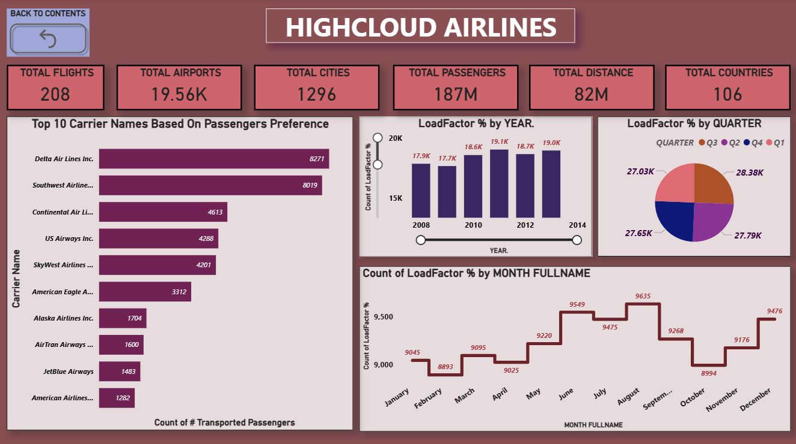
2.1 POWERBI DASHBOARD:

Slide 16
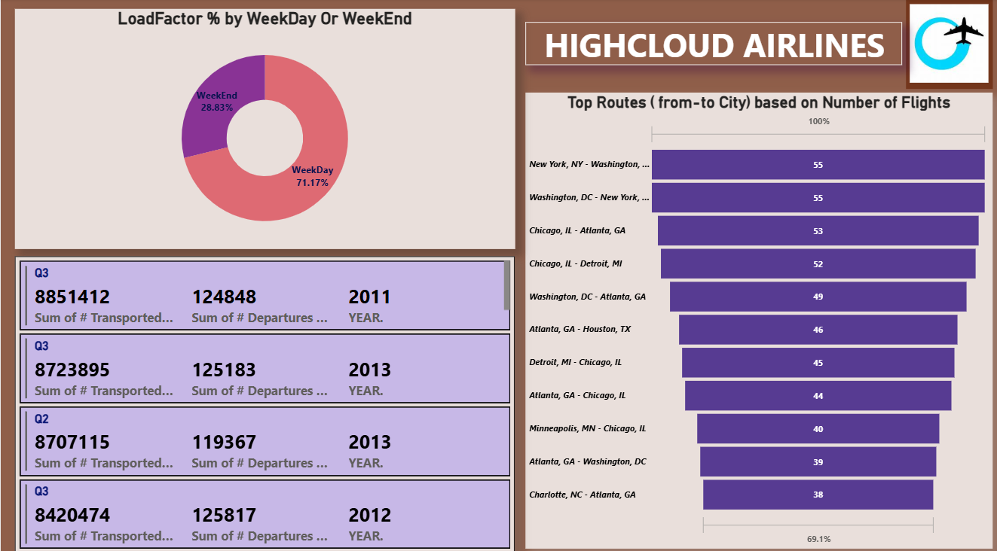
2.2 POWERBI DASHBOARD:

Slide 17
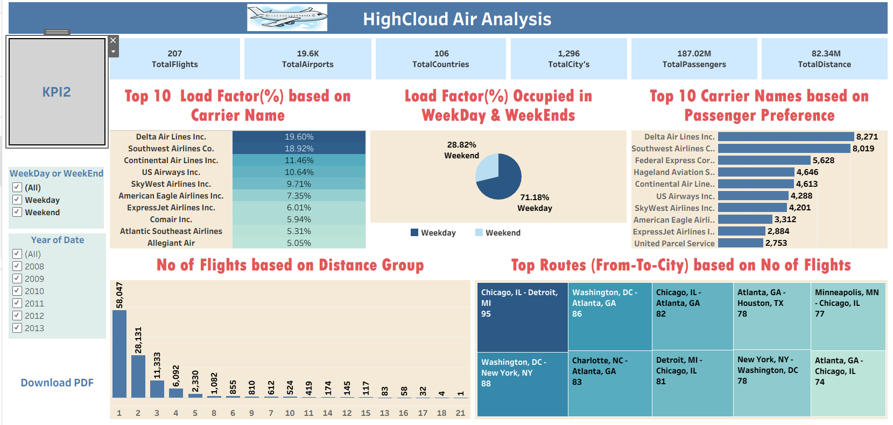
3. TABLEAU DASHBOARD:

Slide 18
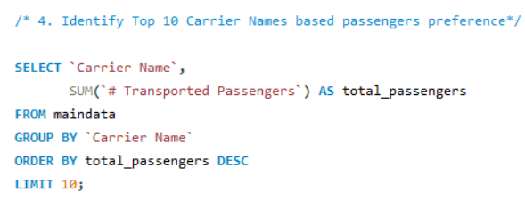
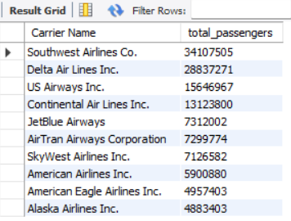
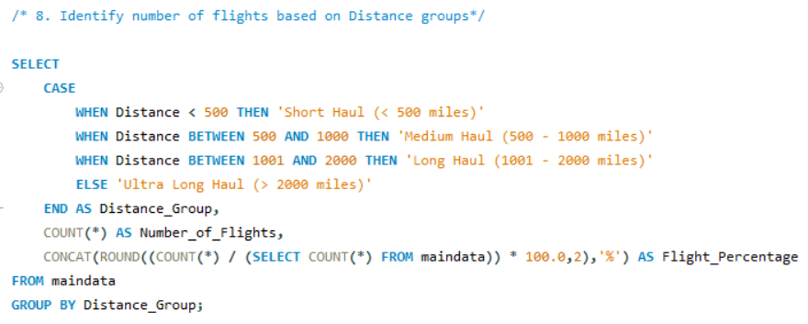
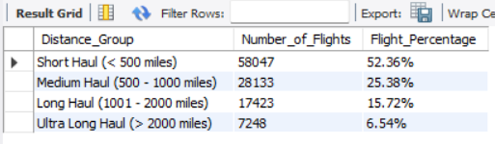
4. SQL QUERY:
4TH KPI – TOP 10 CARRIER NAMES BASED ON PASSENGER PREFERENCE: OUTPUT:
8TH KPI – NUMBER OF FLIGHTS BASED ON DISTANCE GROUP: OUTPUT:

Slide 19
RECOMMENDATIONS
Track load factor performance regularly to identify underutilized capacity and improve route-level profitability.
Focus marketing and loyalty programs around high-demand carriers to enhance customer acquisition and retention.
Analyze top-performing city pairs to strengthen competitive positioning and defend market share.
Implement differentiated pricing and scheduling strategies to capture peak weekend demand and stimulate weekday traffic.
Evaluate carrier efficiency to support performance-based negotiations and strategic collaboration decisions.
Optimize aircraft allocation by aligning short-, medium-, and long-haul operations with profitability and demand trends.

Slide 20
CONCLUSION
The High Cloud Airlines Analysis Project successfully transformed raw airline data into meaningful insights that support informed decision-making. By analyzing passenger trends, load factor performance, route efficiency, and seasonal patterns, the project provides a clear understanding of how effectively airline capacity is being utilized over time.
The interactive dashboards and KPIs developed using Excel, MySQL, Power BI, and Tableau enable stakeholders to identify peak and off-peak periods, optimize routes, improve resource planning, and enhance customer experience. Overall, this project demonstrates how data analytics can play a critical role in improving operational efficiency and driving strategic growth in the airline industry.

Slide 21
THANK YOU

